Slide 1
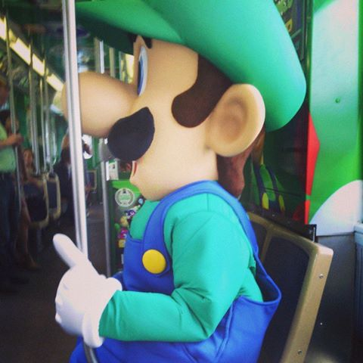
Is this seat taken?: A multi-faceted study to Inform Chicago Transit Authority’s Future Rail Car seating design
Transport Chicago
2014
Maulik Vaishnav
Chicago Transit Authority
Resource Planner
Tara O’Malley
Chicago Transit Authority
Coordinator, Market Research

Slide 2
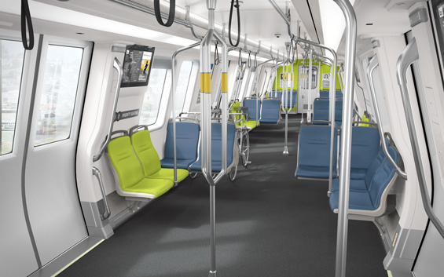
Background
Growing transit agency interest in railcar design across the country.
BART – New Train Car Project
WMATA – 7000 Series
MBTA – Red Max
NY MTA – Off Peak
CTA – MAX, 7000 Series
Theoretical Railcar Capacity Research
Crowded Scenario Standee Space – as small as 2.15 sq ft/person
5.4 sq ft per transverse seat (forward or backward facing)
4.3 sq ft per longitudinal seat (aisle facing)

Slide 3
STUDY Background
CTA operated cars with only transverse seating (front or back facing seats) until the recent introduction of new railcars.
The new 5000 series cars feature longitudinal (aisle-facing) seats.
An opportunity to compare both seating styles with customer feedback, observations, and rail car performance analysis
Focus on busy lines in peak periods and included the older 2400/2600 series, 3200 series, and 5000 series cars.

Slide 4
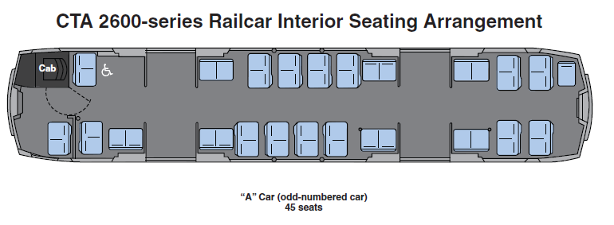
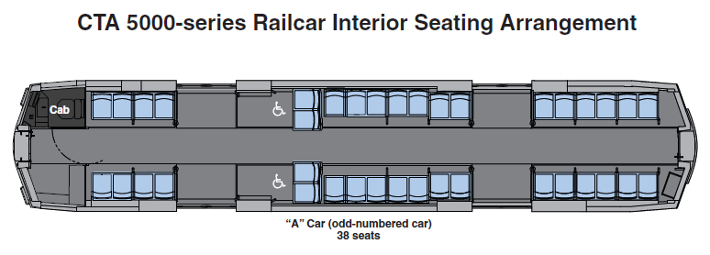
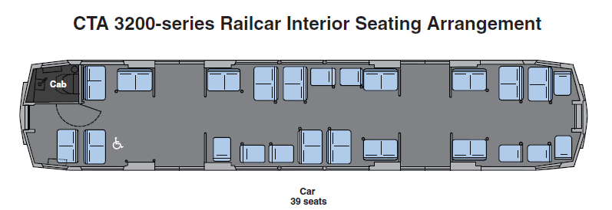
Current Car layouts
Longitudinal Seating 2 ADA spots Horizontal Standing
Support
Lots of Seats Narrow Aisle Limited Standing
Support
Staggered 2x1 Seating ADA spot Poles

Slide 5
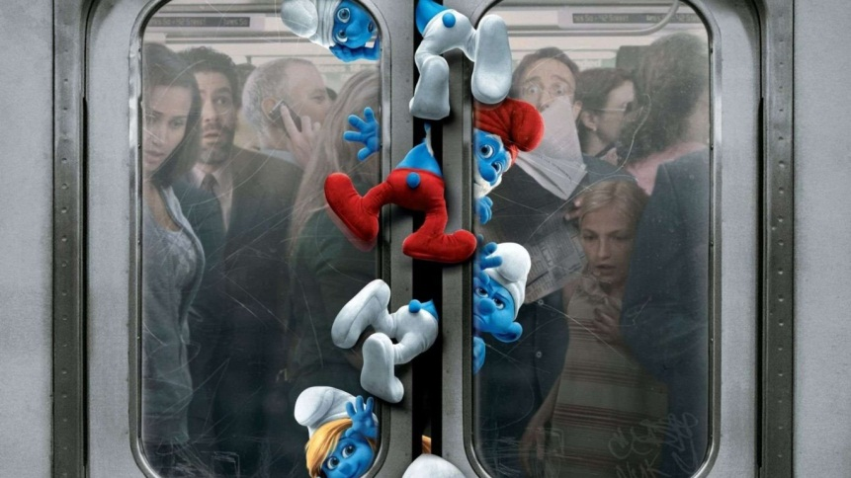
Methodologies
Observations
Dwell time analysis
Observed via surveillance video at various stations
Capacity
Observed onboard individual rail cars
Customer Survey Research
Online
Intercept on the platform

Slide 6
Dwell Time Methodology
Goal is to determine performance differences among rail car types
Stations were selected based on loading and boarding similarities
Observations were conducted in the peak periods
Control for anomalies
Accommodate cases where trains may have been held for delays (signal, operator, etc.,)
Highest 10 percent and lowest 10 percent of observations were removed

Slide 7
Dwell Time Analysis

Slide 8
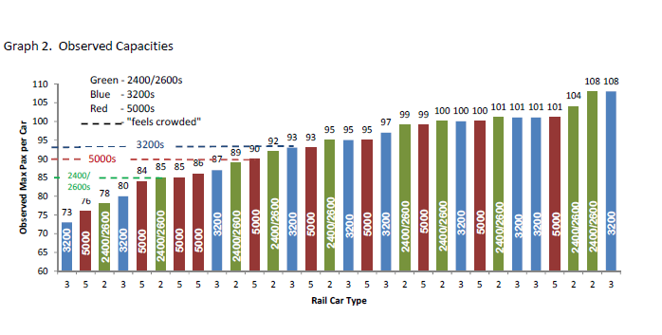
Capacity
2400/2600 Series
Theory: 84-102
Observed: 108
3200 Series
Theory: 94-116
Observed: 108
5000 Series
Theory: 106-134
Observed: 101

Slide 9
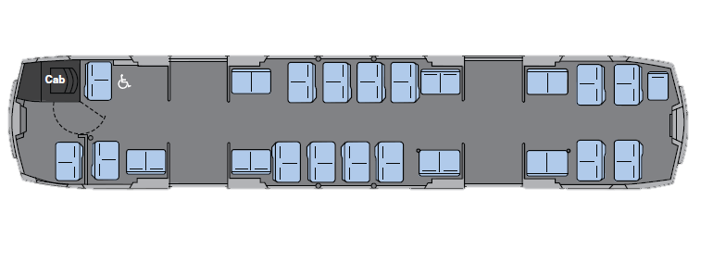
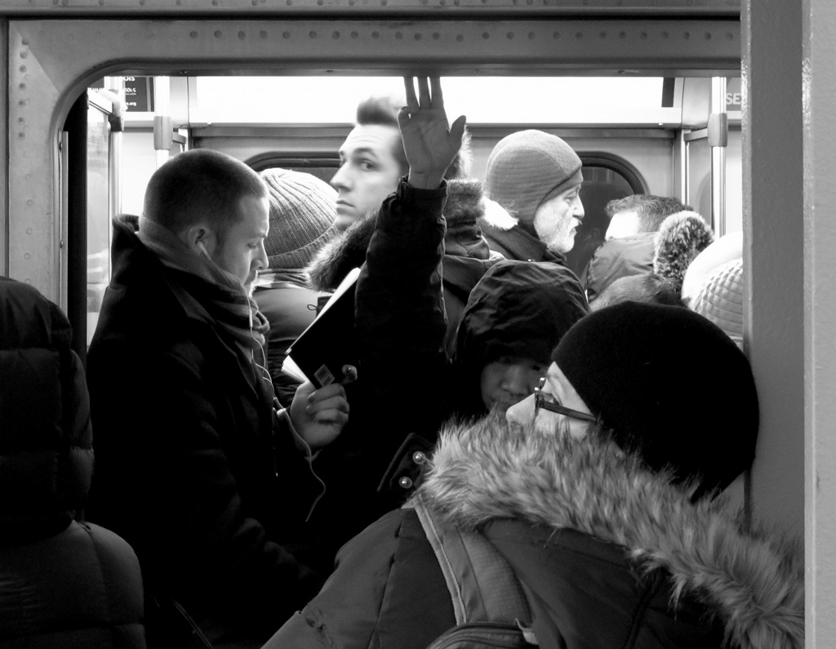
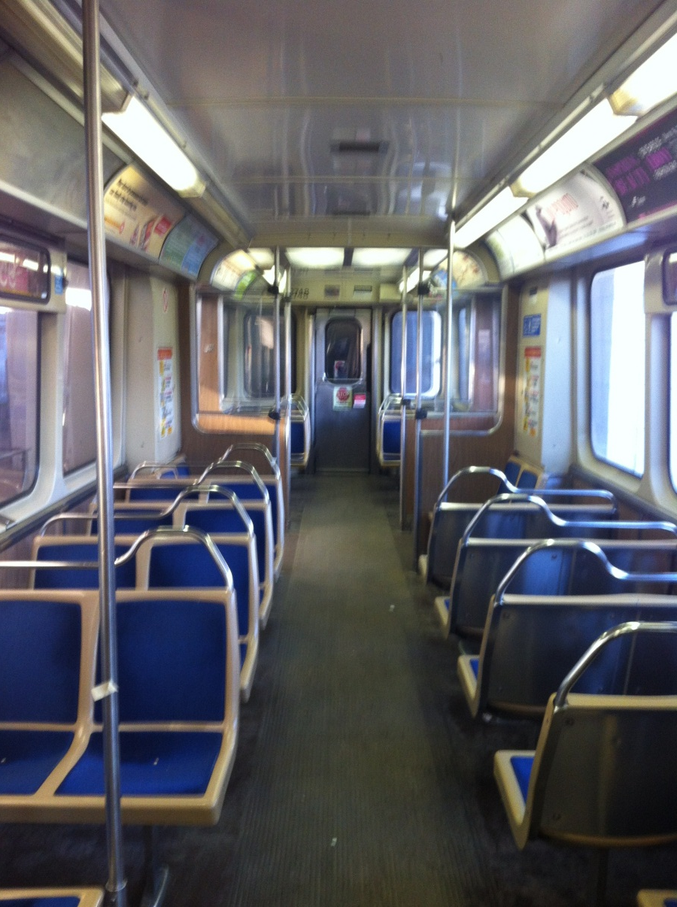
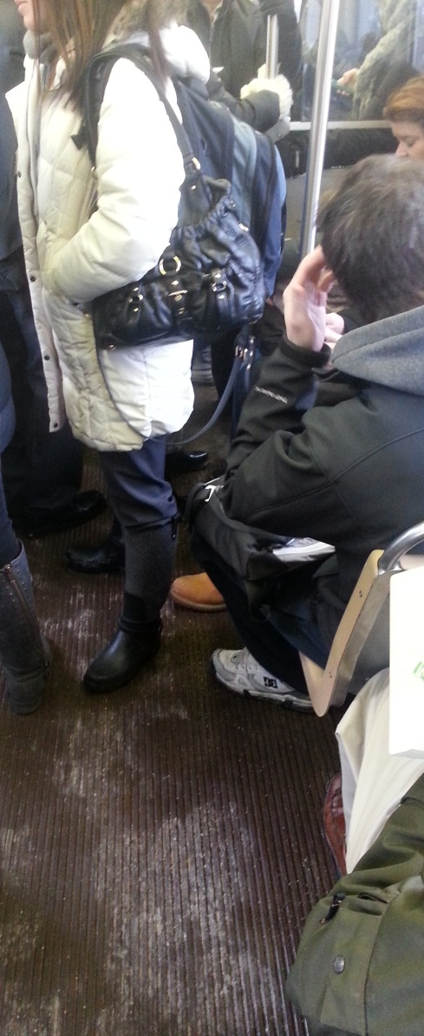
2400/2600 SERIES
Photo Courtesy of Clint McMahon aka “minniepixel” via Flickr

Slide 10
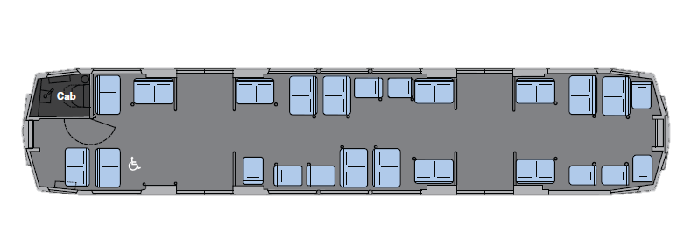
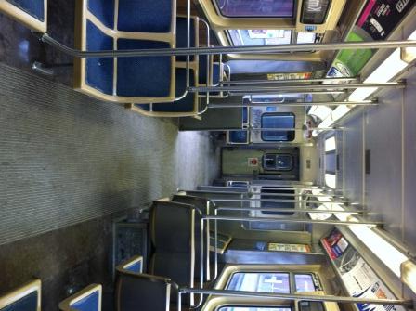
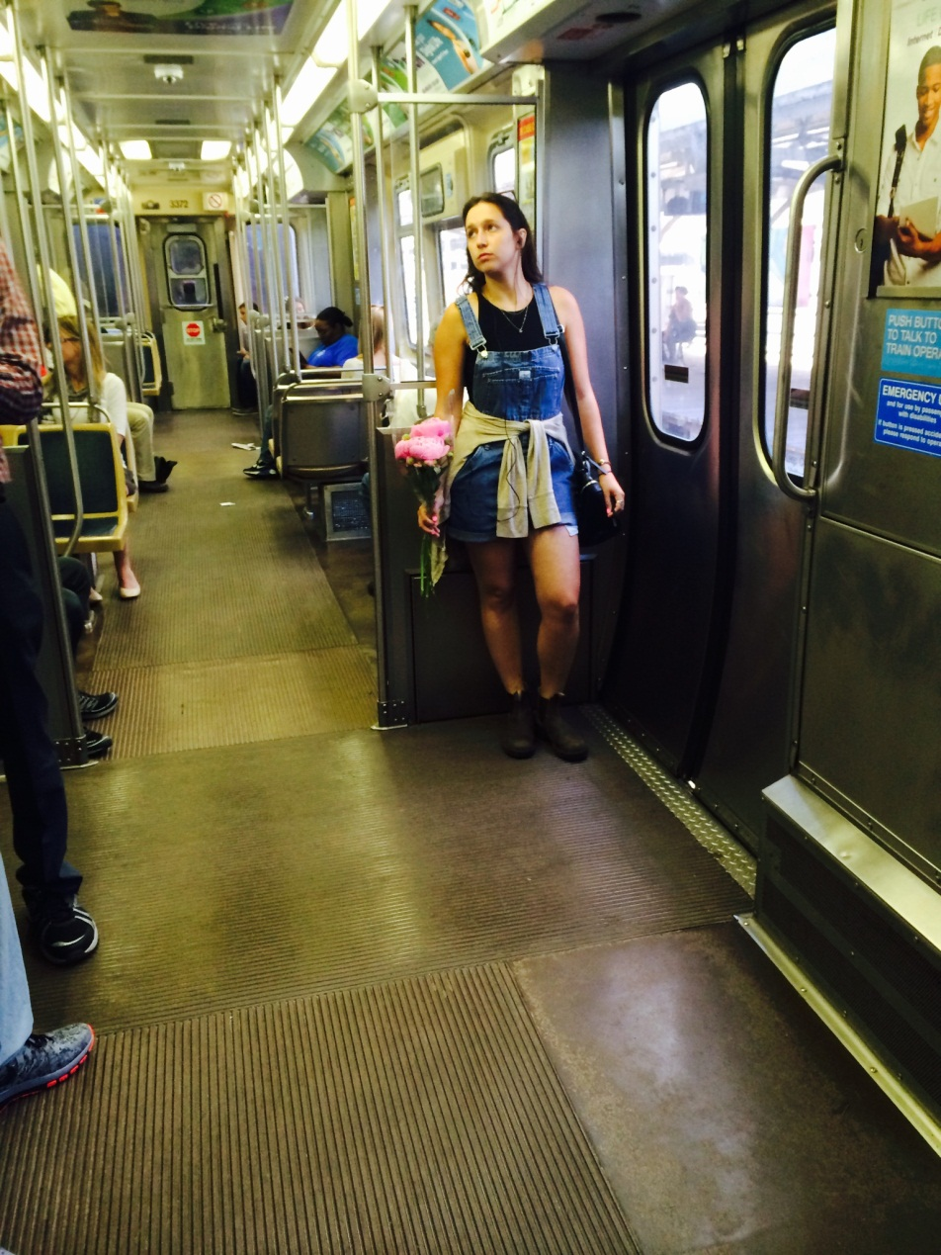
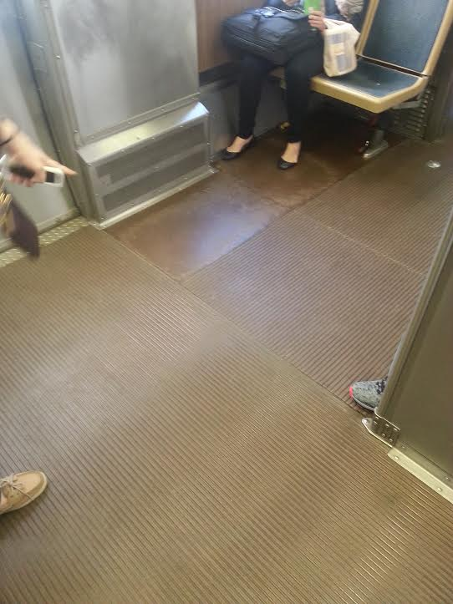
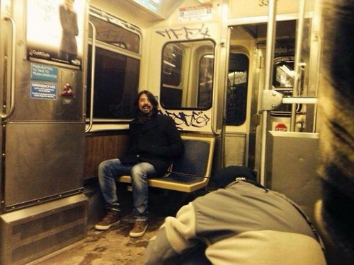
3200 SERIES

Slide 11
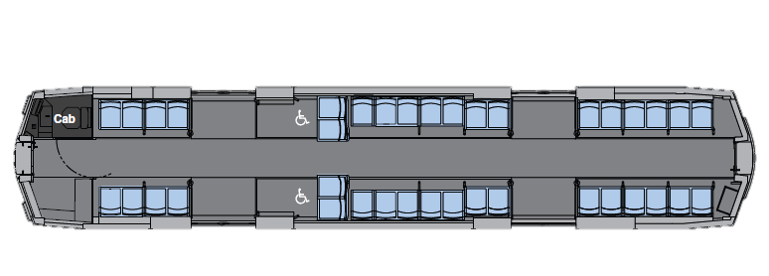
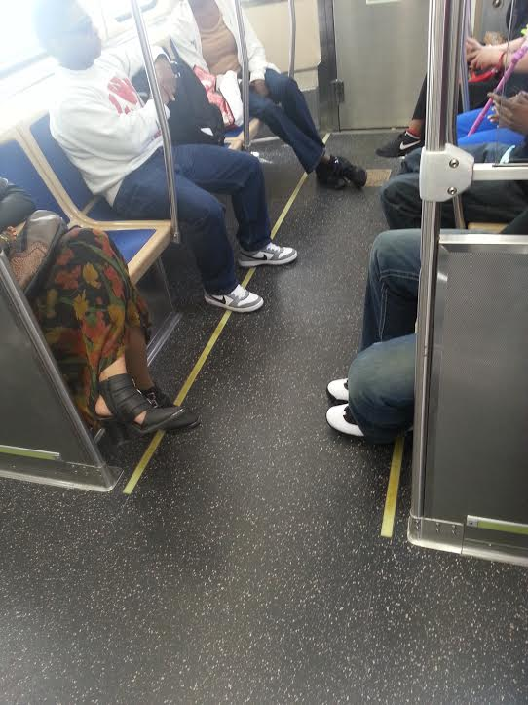
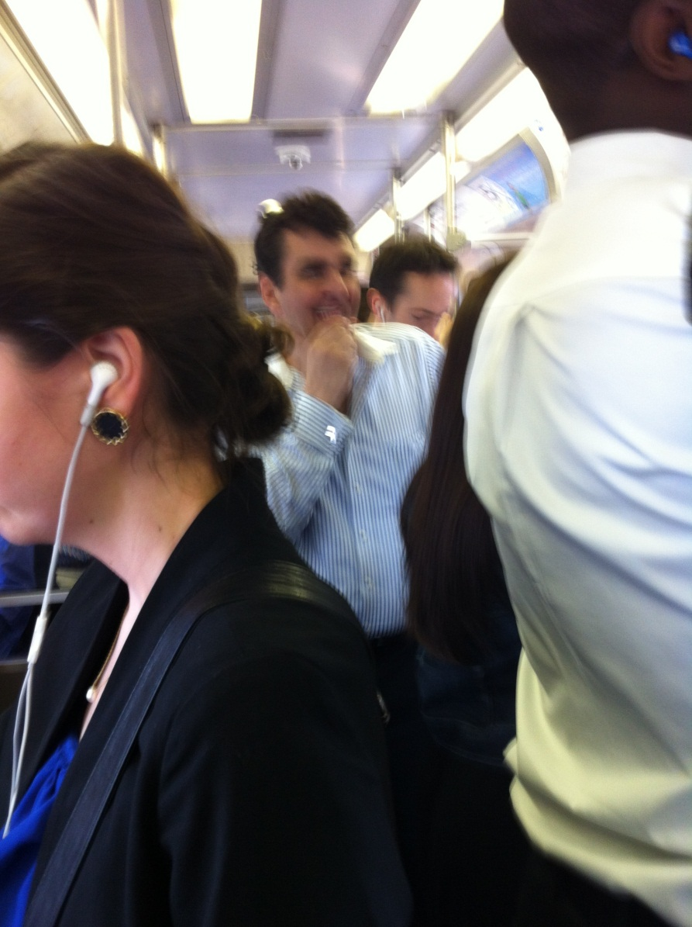
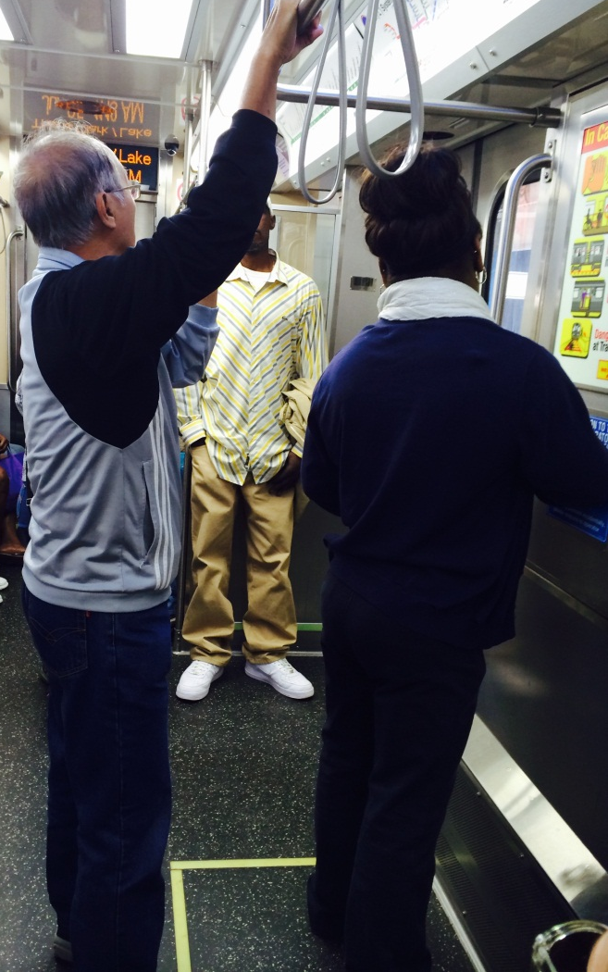
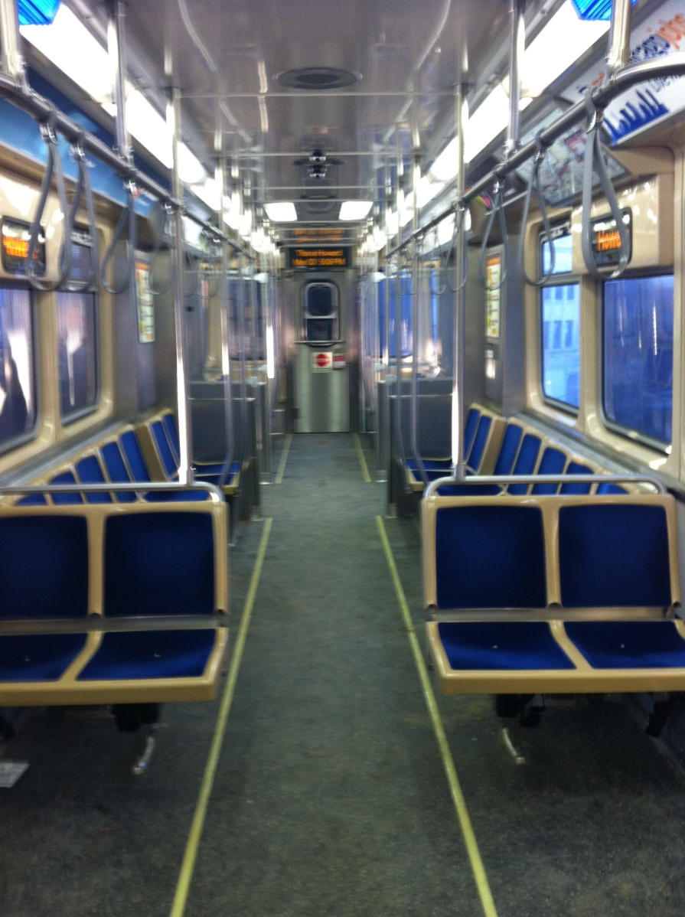
5000 SERIES

Slide 12
Customer Preferences

Slide 13
7000 Series recommendations
Incorporate each car’s benefits in one layout: “A little something for everyone”
Begin with the 3200 series style in the center of the car
Prioritize safety in front: arrange seats facing the center on the cab end of the car
Maximize seats on non-cab end: arrange seats in a two-by-two fashion
Include stabilization elements similar to the new cars

Slide 14
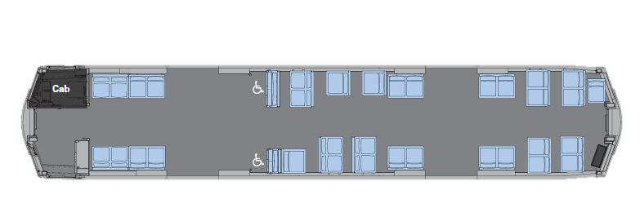
7000 series RECOMMENDATIONS (37 Seats)
Fewer weather panels will help customers move to the center of the car
Two-by-two seats on non-cab end to maximize number of seats
Center-facing seats offer “safer” position in the rail car for customers
Staggered seats like the 3200

Slide 15
Questions?

