Slide 1
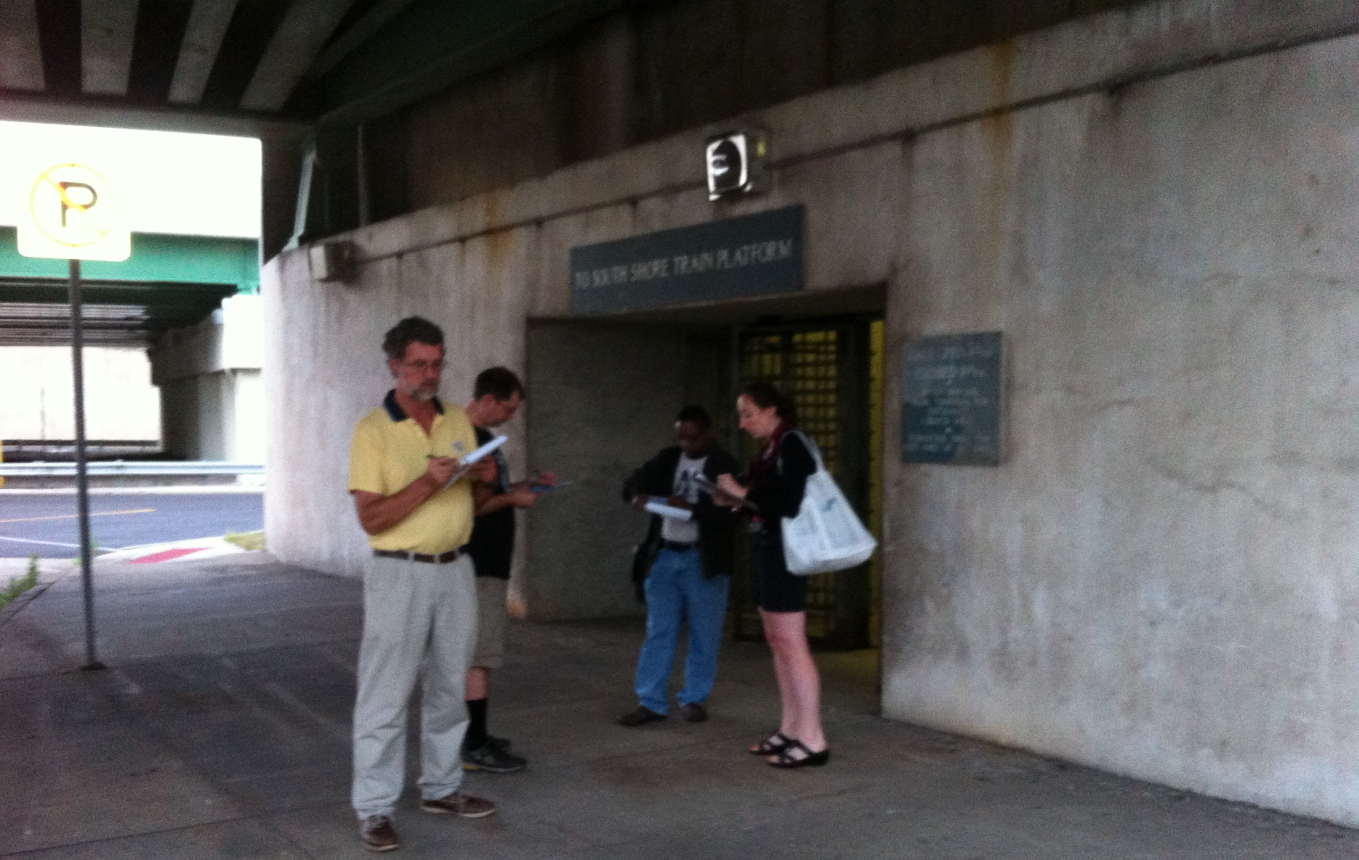
Complete Stations
presented by Active Transportation Alliance on June 6th, 2014
to Transport Chicago
1
Notes:
1
I’m totally cool with changing this slide if you have any other ideas
Amanda introduces Active Trans

Slide 2
Presentation Overview
Introduction to Complete Stations
Activity: Is this station complete?
Discussion

Slide 3
We envision the region with half as many crashes and where half of all trips are made by walking, biking and transit.

Slide 4
What are Complete Stations?
Easy to access using any mode of transportation
Encourage healthy, cost efficient travel habits
Fulfills all the needs of transit riders
Makes taking the train an easy choice
Notes:
A complete station is one that fulfills all the needs of transit riders, and makes taking the train an easy choice.
It offers amenities such as shelter, route information and ticketing, handicap accessibility and more
It is accessible via all modes of transportation including biking, walking, driving, and local buses
This assessment helps communities take a close look at their local train station and identify improvements that could better serve the needs of riders.
Creating a complete station can help turn a local transit stop into the center of a community and encourage more people to use public transit.
Complete Stations make it easier to walk and bike to the train, encouraging healthy, cost efficient travel habits.
The Complete Stations Assessment is designed for community groups to use without any professional help, and is applicable for any train station in the Chicago region. If you are interested in conducting a Complete Stations Assessment for a station in your community, visit www.activetrans.org.

Slide 5
What are Complete Stations Assessments?
The Complete Stations Assessment is designed for community groups to use without any professional help, and is applicable for any train station in the Chicago region.
Goal: Translate community need into useful and actionable data for decision makers and professionals.

Slide 6
Complete Stations version 1.0
Development and testing phase
Kane County
Six Metra Stations
Aurora
Geneva
La Fox
Elburn
National Street (Elgin)
Elgin
Big Timber (Elgin)
Notes:
Project funded through a grant for Kane County Department of Public Health, creating Healthier Communities Grant
Initial goal was to develop
Six Metra stations visited by Active Trans Staff. evaluated independently, using checklist, limited input from public
Met with/discussed final evaluation with representatives (municipal staff) from each community
Results/Recommendations reviewed by Metra

Slide 7
Complete Stations version 1.0
Notes:
Discuss and describe each element of this analysis (11 elements total)

Slide 8
Complete Stations version 1.0
Useful technical analysis tool
Engaged municipal staff in discussions
Low cost and high cost improvements identified improvements identified
Limited implementation
Notes:
Outcomes
Useful technical analysis, but not linked to a larger study
Kane Co DOT reviewed and will be considering some of the long term improvements
Shared and utilized by a planner in duPage county
Major challenges: one time report without strategy for implementation, limited community engagement, LOTS of agencies (Municipal, Pace, Metra, Railroad, County, State) involved so very difficult to implement changes/recomemdantions

Slide 9
Complete Stations version 2.0
Community based initiative
Simplified assessment tool
Notes:
Use this slide to talk about development of version 2.0 and topics covered in the new version

Slide 10
Complete Stations version 2.0
Elmhurst-
Elmhurst Bike Club
Addison Blue Line-
Avondale Neighborhood Assoc., Addison Avondale Mural Garden
Kedzie Metra-
Breakthrough Urban Ministries
Kostner Pink Line-
Little Village Environmental Justice Org (LVJEO)
Gary Metro
Gary Rotary Club
Clybourn Metra (late June 2014)

Slide 11
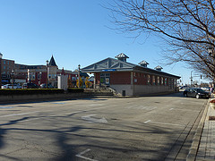
Complete Stations version 2.0
Elmhurst Metra
Notes:
Use these slides to tell stories from each of these stations

Slide 12
Complete Stations version 2.0
Gary Metro
Notes:
Use these slides to tell stories from each of these stations

Slide 13
Complete Stations version 2.0
Addison Blue Line
Notes:
Use these slides to tell stories from each of these stations

Slide 14
Activity: Try the Complete Stations Assessment
Small groups of 3-4
Review photo package
Answer a few questions from each section

Slide 15
Discussion
What worked? What did you like about the assessment?
What’s missing? How could we make this better and more useful?
What possibilities exist for using this tool in your work?

Slide 16
Discussion Notes
What worked? What did you like about the assessment?
Call attention to things that people might take for granted on their regular commute
Covered the entire experience
Good to ask about cleanliness
Good to ask about amenities in the station (security, vending, staff present)
This is a short checklist-people don’t get lost in the details

Slide 17
Discussion Notes
What’s missing? How could we make this better and more useful?
Find a way to capture more of the qualitative info
Use more inclusive language
Often multiple auxiliary entrances
Use more examples and photos of infrastructure
Missing questions about parking-Is the parking lot present, safe, and visible? How are drivers interacting with people on foot, bike?
A question about noise issues
A question about cell phone service
A mobile version of the checklist to use on a cellphone

Slide 18
Discussion Notes
What possibilities exist for using this tool in your work?
Work with children-they have good ideas and aren’t jaded

Slide 19
Contact Information
Jim Merrell
Campaign Director
9 West Hubbard Street
Suite 402
Chicago, IL 60654-6545
T 312.427.3325 X 236
F 312.427.4907
jim@activetrans.org

